Slide 1
Hargreaves Services plc AGM
Wednesday 30 October 2024

Slide 2
Strategic Overview
Services
Organic growth to support long term sustainable dividend
Focus on contract wins in areas of core competence
Land
Realisation of renewable assets
HRMS
Maximise cash repatriation
DK operational turn around
Reduce capital employed from c£80m to c£20m

Slide 3
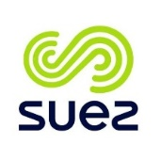
Services – Resilience and quality
Major Customers
Frameworks
and term contracts
65+
Secured orders as 31 May 24
c.70%
Typical operating margins
5%+
£’m
PBT
Revenue resilience
Services operates across four core market sectors, limiting the risk of over exposure to one particular market
Credit exposure
No over reliance on a single customer; largest debtor represents 9% of total book.
Inflation resistant
Many contracts are defined cost plus a margin with built in inflation and escalation factors to protect margin

Slide 4
Services – Growth opportunities
Major infrastructure projects
HS2 –
A further two years work at least remaining
Sizewell C – enabling projects underway
Lower Thames Crossing – preferred partner to Balfour Beaty
Tungsten West – strong contractual position with TW awaiting funding
Contract successes
Secured three-year position with Stirling Council on transportation services
Renewal of five-year NEC position in Hong Kong for CLP Power Ltd
Materials handling contract secured for five years for Yorkshire Water

Slide 5
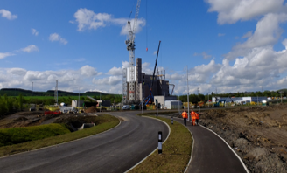
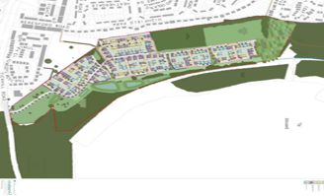
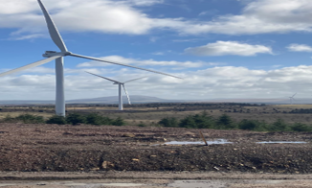
Hargreaves Land – Key Events FY24
Sale of Westfield EFW Ground Lease Investment
Sale of Residential site Maltby, Rotherham
Continued Development of Renewables Asset Portfolio
50-year ground lease investment
Net consideration £7.6m
Investment yield 5.3%
Planning permission secured for 185 plots
Net consideration £4.9m
Renewables rental income rose to £798k p.a. (FY23 £230k)
Three further renewables agreements exchanged (510MW) in FY24
5

Slide 6
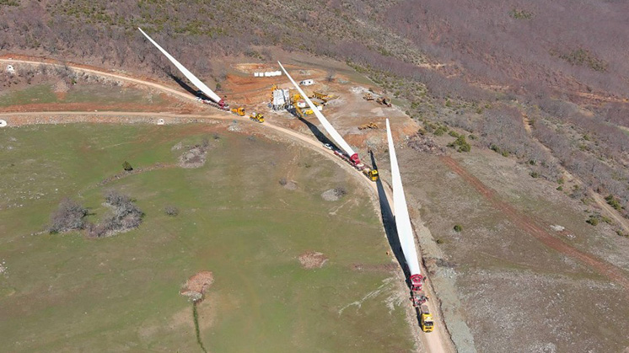
Hargreaves Land – Renewables portfolio
Status |  |  | Book Value | Independent Valuation
OPERATIONAL | 2 Windfarms 2 Access Agreements | 216 MW | £7.4m | £27m-£29m
UNDER CONSTRUCTION | 1 Windfarm 2 Access Agreements | 230 MW
PRE-CONSTRUCTION | 1 Windfarm 2 Access Agreements 1 Battery Storage | 952MW
 | 11 Schemes | 1,398MW
CONTRACTED, Pre-Planning | 1 Access Agreement 1 Wind Farm 1 Battery Storage | 510 MW | Negligible | n/a
Non-contracted pipeline | 7 schemes | 1,185MW | Negligible | n/a
First tranche of renewables assets to be taken to market with an estimated valuation of £10m +

Slide 7
Hargreaves Raw Materials GmbH - Trading
Profits from trading in HRMS have been variable over the period of ownership, given dependency on commodity cycles and market pricing.
Normalised trading levels expected to deliver between £8m and £16m – higher than prior to the acquisition
DK acquisition in December 2019 provides greater synergies to trade on higher volumes

Slide 8
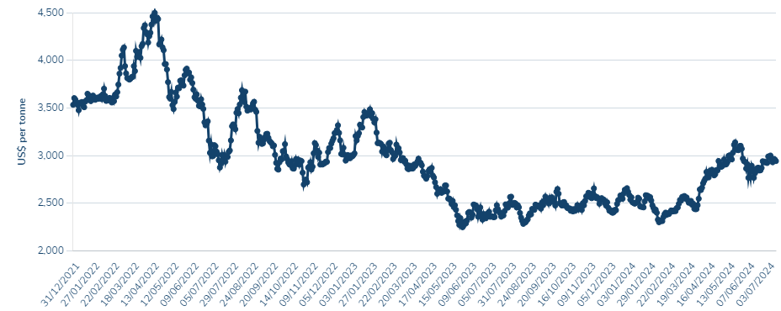
DK Recycling und Roheisen GmbH – Material outputs
Efficiency improvements
Lower cost coke sourcing in place for the coming year
EU phased embargo expected to have positive impact on pig iron
Other initiatives
Renegotiated gate fees for steel waste dusts
Variables in FY24
Pig Iron sales price – 28% reduction
Coke purchase price – 25% reduction
3% squeeze on margin – impacted by inequitable sanctions on imports
Zinc
Recovery in zinc pricing in second half of the year.
90% of zinc output now hedged for coming year.

Slide 9
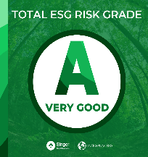
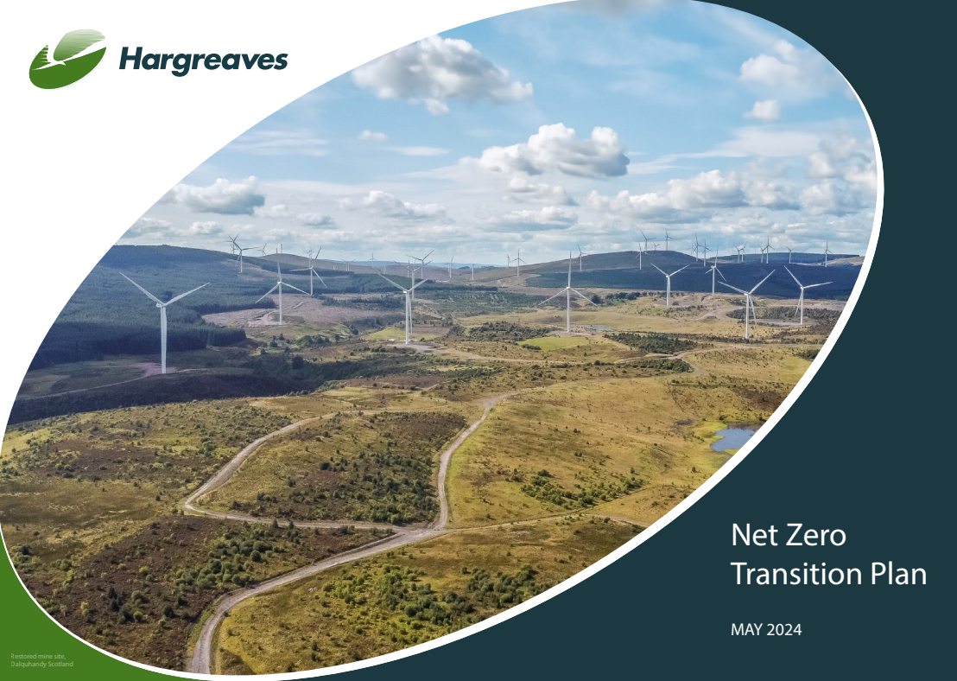
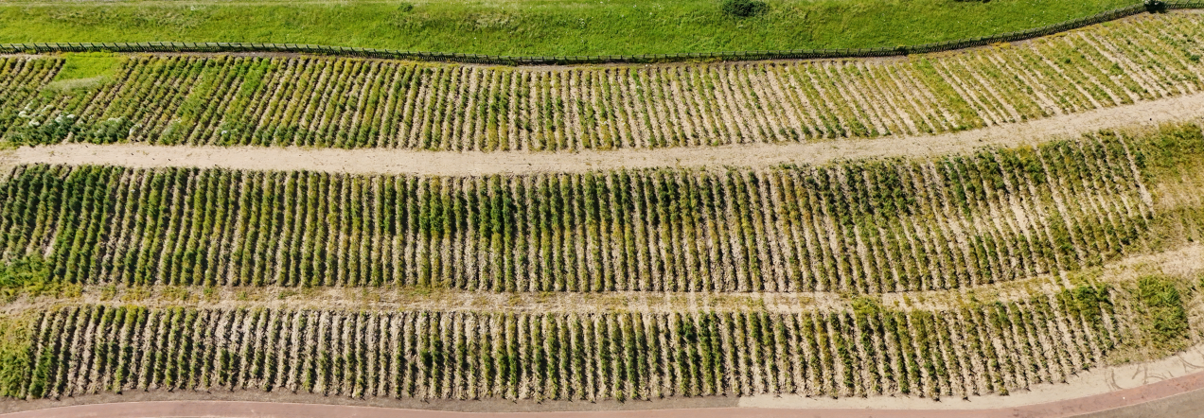
Hargreaves Services plc – ESG
Environmental
Monitors and reports how the Company controls its impact on the environment
Social
Examines how the Company manages its relationship with employees, suppliers and communities
Governance
Controls and monitors how the Company deals with its leadership, internal controls and shareholders, including in the areas of E & S
Net Zero published, targeting phased reduction to zero carbon by 2050
Over 170,000 trees planted on land owned by the Group
Achieved Supply Chain Sustainability School Silver rating
Targeting Gold in FY25

Slide 10
Hargreaves Services plc – Outlook
Services
Over 70% of revenues secured under contract for new financial year providing confidence in the continued delivery of sustainable and reliable profits into the future
Group Outlook
Trading outlook for FY25 is strong led by Services and Hargreaves Land
Free from bank debt and pension liability
Sustainable full year dividend increased to 36p
Land
First tranche of renewable energy land assets going to market in FY25
Growing pipeline of development opportunities
HRMS
Second half DK improvement gives confidence for the new financial year
Focus remains on cash returns from the joint venture

